Slide 1

1.5 Stored Program Computer
27
Although computers have become faster and more reliable, the same principal components have been present since the beginning of the stored program computer.
A stored program computer stores the program so that you can change the program without changing the machine

Slide 2
1.5 Mechanical Calculators
27a
The opposite of a stored program computer is a device like a calculator where you have to input each step one at a time.
Mechanical calculators have existed since the 1600’s.
Development limited by ability to machine the parts.
Handheld electronic calculators were invented in the 1970’s, overlapping stored program technology.

Slide 3
1.5 Jacquard Loom
27b
Possibly the first stored program computer
French Industrial Revolution (1800’s)
Related to punch cards (“IBM cards”)
Could weave different complex patterns by using a different program (deck of cards)
Still used today in less industrialized parts of the world

Slide 4
1.5 Historical Development
27c
The evolution of the stored program computer is usually classified into four generations according to the underlying technology.

Slide 5
1.5 Punched card tabulator
28
Generation Zero: Mechanical Calculating Machines
  Punched card tabulating machines - Herman Hollerith (1860 - 1929)
  Used in the 1890 census
  Hollerith cards (“IBM cards”) used as input through the 1970’s
  80 columns = 80 character input line
  EBCDIC format still used in IBM machines today

Slide 6
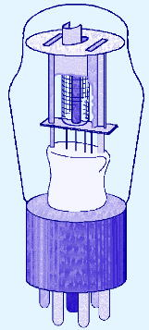
1.5 Atanasoff
29
The First Generation: Vacuum Tube Computers (1945 - 1953)
  Atanasoff Berry Computer (1937 - 1938) solved systems of linear equations.
  John Atanasoff and Clifford Berry of Iowa State University.
  First totally electronic machine
  Destroyed during department cleanup

Slide 7
1.5 ENIAC
30
The First Generation: Vacuum Tube Computers (1945 - 1953)
  Electronic Numerical Integrator and Computer (ENIAC)
  John Mauchly and J. Presper Eckert
  University of Pennsylvania, 1946
  Lawsuits over whether Atanasoff or Mauchly and Eckert should get credit for inventing the computer

Slide 8
1.5 ENIAC
30a
First general-purpose computer.
17000 vacuum tubes
Two large rooms
One room for its air conditioning unit
30 tons
A few vacuum tubes burnt out every day
Memory approx. 125 bytes
1960’s radio with vacuum tubes about the size of a toaster

Slide 9
1.5 Historical Development
31
The First Generation: Vacuum Tube Computers (1945 - 1953)
  The IBM 650 first mass-produced computer. (1955)
    It was phased out in 1969.

Slide 10
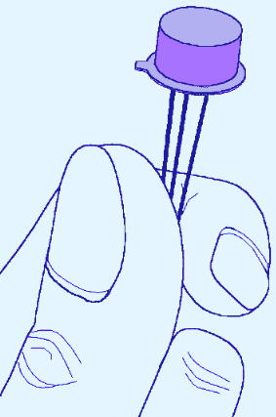
1.5 Historical Development
32
The Second Generation: Transistorized Computers (1954 - 1965)
  Transistors more reliable than vacuum tubes
  IBM 7094 (scientific) and 1401 (business)
  Digital Equipment Corporation (DEC) PDP-1
  and many others
  Each of these computers had a different architecture
  Less than 1MB of memory

Slide 11
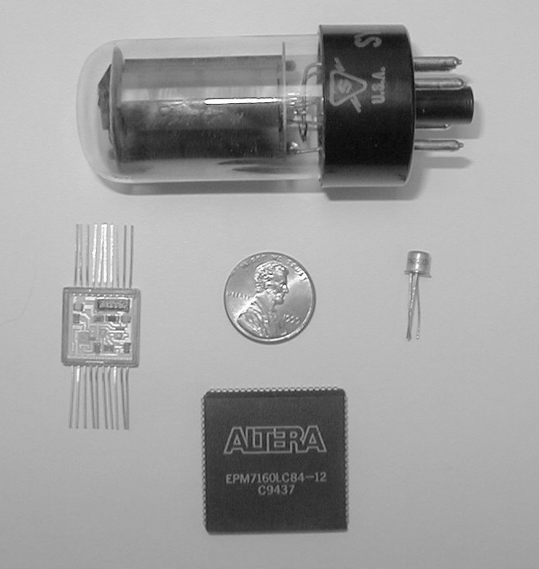
1.5 Historical Development
32a
Relative sizes
(clockwise from top)
  Vacuum tube
  Transistor
  Chip with 2000 NAND gates
  Integrated circuit package

Slide 12
1.5 Historical Development
33
The Third Generation: Integrated Circuit Computers (1965 - 1980)
  IBM 360/370
  DEC PDP-8 and PDP-11
  Cray-1 supercomputer
  . . . and many others
  Beginning of the modern era
    System software (operating systems and compilers)
    Application software

Slide 13
1.5 Historical Development
33a
Dominance of IBM.
  By using the same architecture, IBM provided an upgrade path
  Same architecture but not necessarily same hardware design
  Scientific and business machines
    Scientists need floating point
    Business people don’t want roundoff error
IBM was the Microsoft of its day
  But no longer is
  History repeats itself? What will be the future of Microsoft?

Slide 14
1.5 Historical Development
34
The Fourth Generation: VLSI Computers (1980 - ????)
  Very large scale integrated circuits (VLSI) have more than 10,000 components per chip.
  Enabled the creation of microprocessors.
  8080, 8086, and 8088 chips used in first personal computers in early 80’s
  Earliest PCs had no hard disk
    360KB per floppy disk (later 1.4MB)
    Ran only one application at a time

Slide 15
1.5 Historical Development
34a
Backwards compatibility
  Backwards compatibility is the ability of a new machine to run software intended for the previous generation
  Essential to modern software industry because users want to spend their money on their core business, not on rewriting or converting software

Slide 16
1.5 Historical Development
34b
Importance of backwards compatibility
  Current PC architecture became near-universal not because it was a good one but because it was created at the right time
  Newer machines needed backward compatibility, so we are stuck with that architecture (and its successors) forever
  IBM has also provided backwards compatibility for its mainframe line

Slide 17
1.5 Historical Development
35
Moore’s Law (1965)
  Gordon Moore (founder of Intel) in 1965: The density of transistors in an integrated circuit will double every year.
  More recent version: Density of silicon chips doubles every 18 months.
Just an approximation
  Not a real law like that law of gravity.
  That’s why different people have different versions.
Can’t last forever
  Eventually you’d have transistors smaller than an atom!

